Slide 1


.NET Aspire: Cloud-Native Without the Chaos
Emiliano Montesdeoca
Cloud Dev Team lead @ Intelequia
Microsoft MVP Developer Technologies
@emimontesdeocaa

Slide 2



Emiliano Montesdeoca
Cloud Dev Team Lead at Intelequia
Microsoft MVP & International speaker
Loves Microsoft stack
Team 1995!
Got 2 amazing puppies 🐶
Uruguayan and Spanish
Bunch of tattoos!
Happy to be here!!
emimontesdeoca@outlook.es
in/emimontesdeoca/
@emimontesdeocaa
@emimontesdeocaa

Slide 3
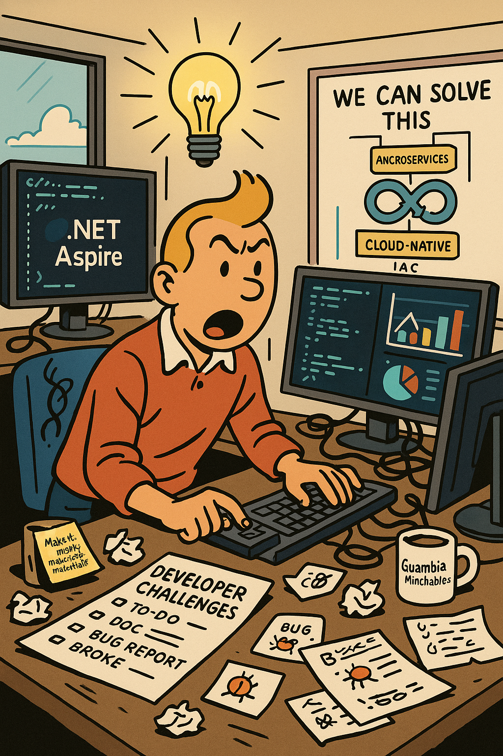
Struggles of developer experience
How can we solve this?
Developer challenges
.NET Aspire
Demo
@emimontesdeocaa

Slide 4
Struggles of developer experience
Why am I always sad when I develop?
@emimontesdeocaa

Slide 5

What is Developer Experience?
Refers to the overall experience and satisfaction that developers have while using tools, platforms, and processes to build software.
It encompasses everything that affects a developer’s ability to perform their tasks efficiently and enjoyably.
Impact on Productivity and Efficiency
Quality of software
Developer satisfaction and retention
@emimontesdeocaa

Slide 6
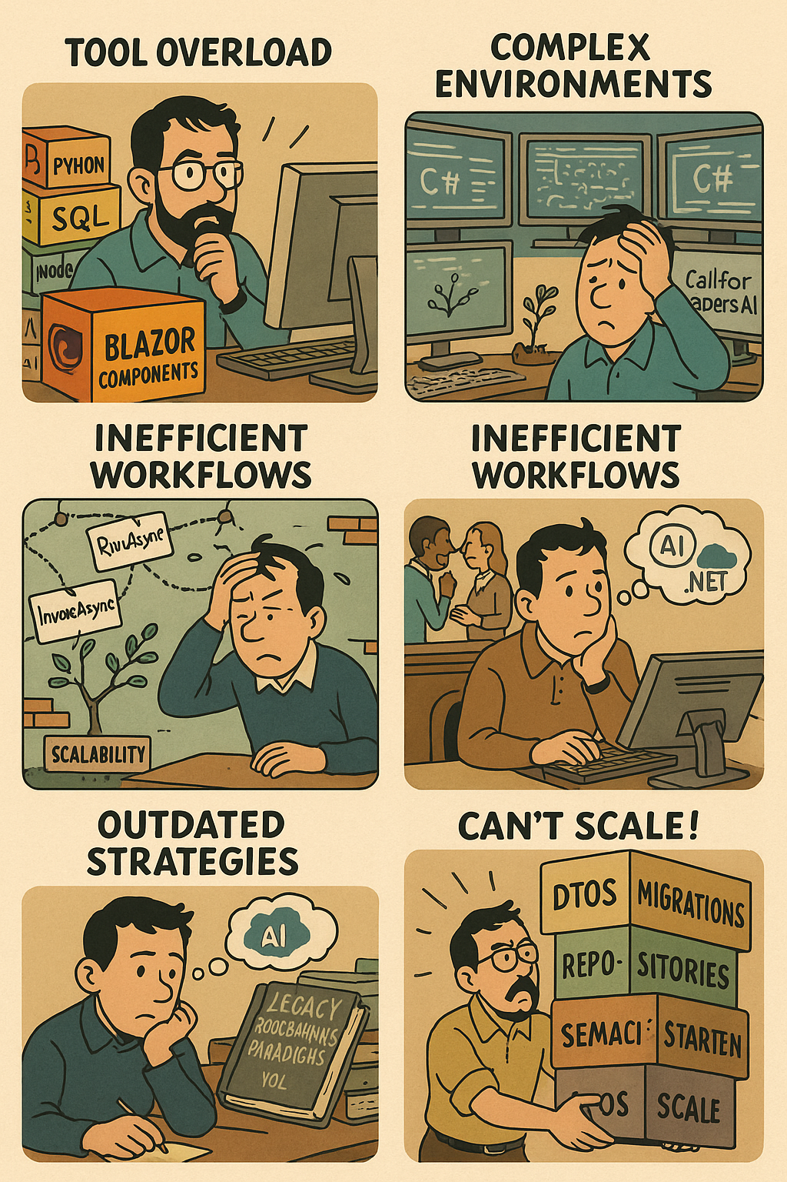
Challenges Developers Face Today
Tool Overload
Complex environments
Limited Scalability
Inefficient Workflows
Knowledge Silos
Outdated strategies
Can’t scale!
@emimontesdeocaa

Slide 7
How can we solve this?
Yeah you came for this most likely…
@emimontesdeocaa

Slide 8
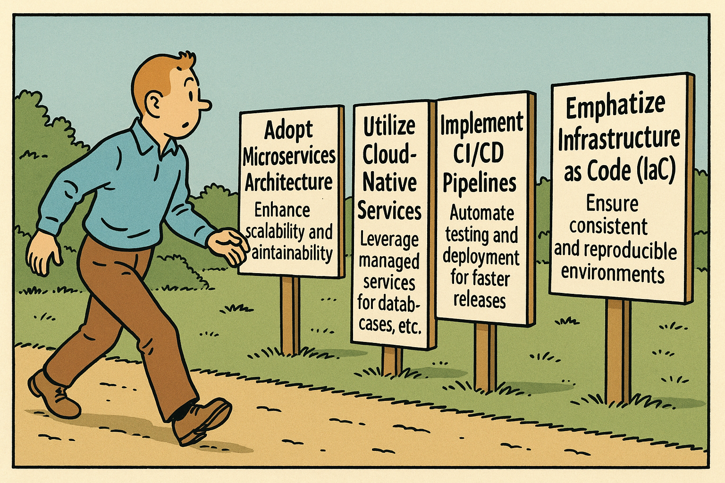
Strategies for Building Cloud Apps
Adopt Microservices Architecture: Enhance scalability and maintainability.
Utilize Cloud-Native Services: Leverage managed services for databases, caching, etc.
Implement CI/CD Pipelines: Automate testing and deployment for faster releases.
Emphasize Infrastructure as Code (IaC): Ensure consistent and reproducible environments.
Monitor and Optimize Performance: Use monitoring tools to track and improve app performance.
@emimontesdeocaa

Slide 9
.NET Aspire
The solution to all our problems… right?
@emimontesdeocaa

Slide 10

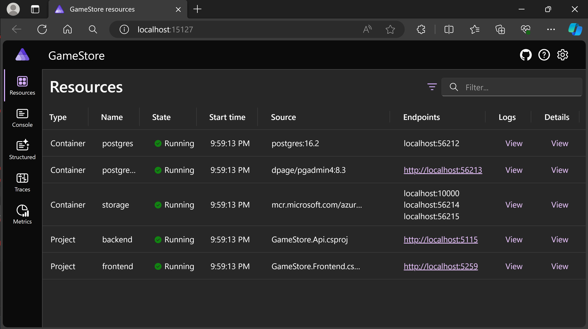
.NET Aspire – an overview of a godsent tool
Provides tools, templates, and packages to help you build observable, production-ready apps.
Delivered through NuGet packages, .NET Aspire simplifies common challenges in modern app development.
@emimontesdeocaa

Slide 11
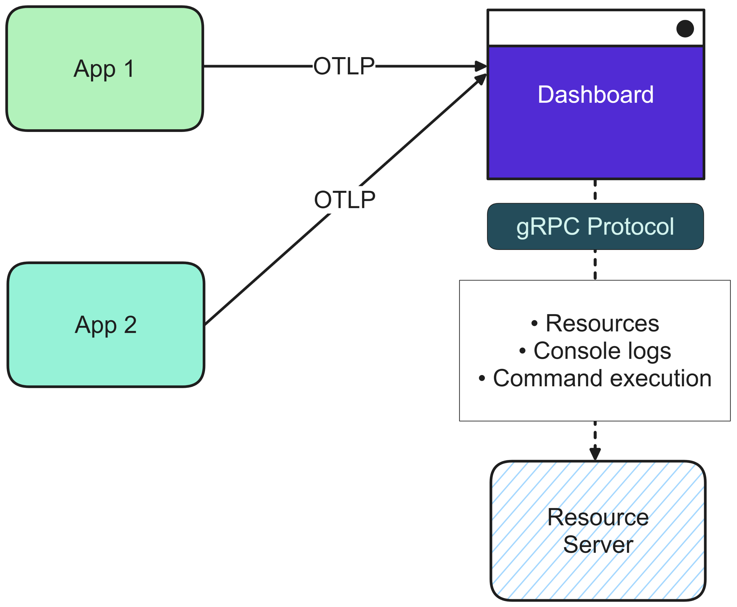
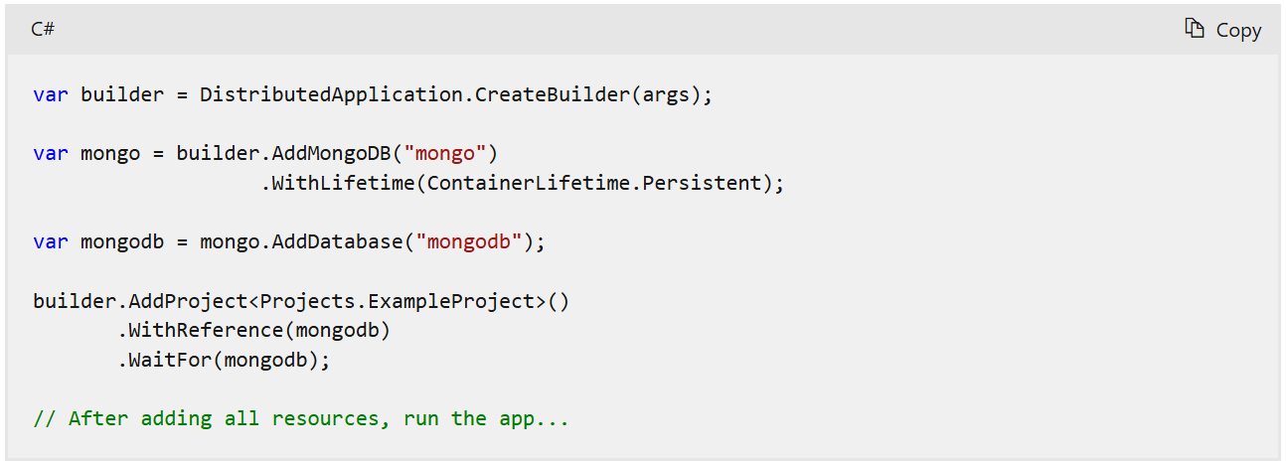
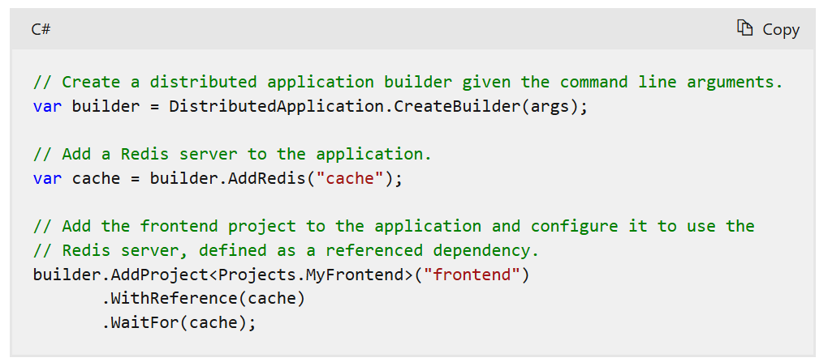
.NET Aspire – 3 main characteristics
Dev-time orchestration
.NET Aspire integrations
Project templates and tooling
Orchestration primarily focuses on enhancing the local development experience by simplifying the management of your app's configuration and interconnections.
Integrations are NuGet packages designed to simplify connections to popular services and platforms, such as Redis or PostgreSQL.
.NET Aspire provides a set of project templates and tooling experiences for Visual Studio, Visual Studio Code, and the .NET CLI.
@emimontesdeocaa

Slide 12
It’s demo time!
No more slides!
@emimontesdeocaa

Slide 13
References
https://github.com/emimontesdeoca/global-azure-2025-accra-net-aspire
https://aka.ms/aspire
https://devblogs.microsoft.com/dotnet/category/dotnet-aspire/
https://x.com/davidfowl
https://x.com/emimontesdeocaa
@emimontesdeocaa

Slide 14
@emimontesdeocaa

